Slide 1
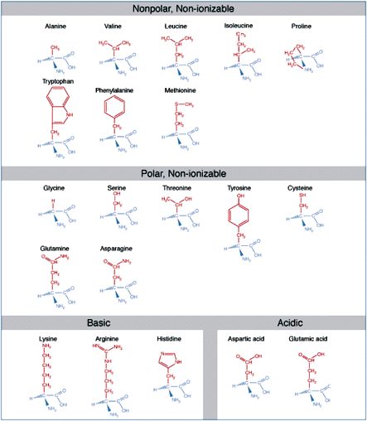

Slide 2
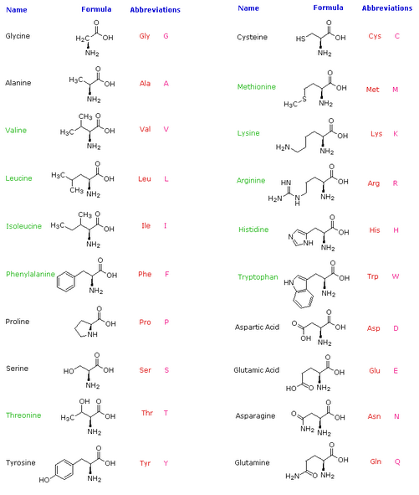

Slide 3
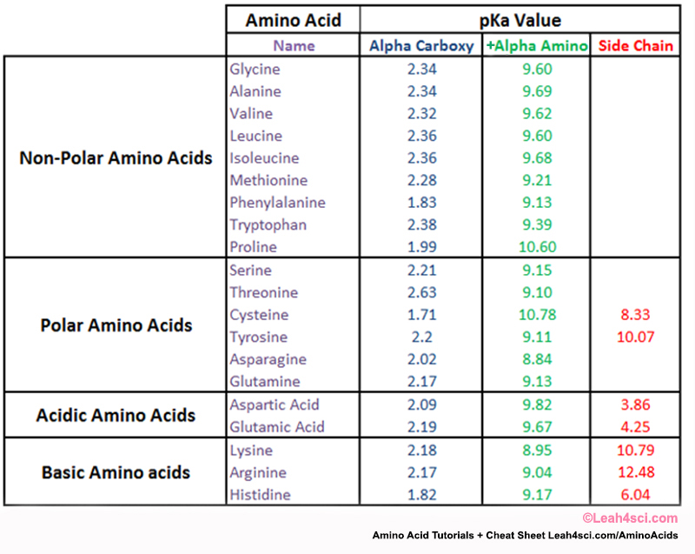

Slide 4
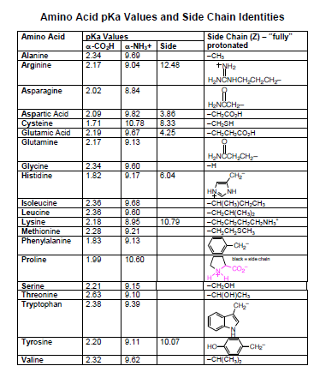
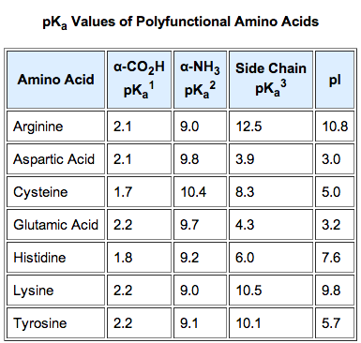

Slide 5
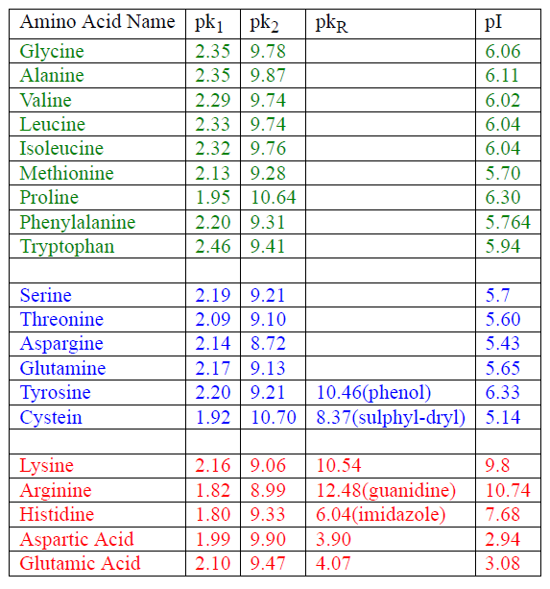

Slide 6




Threonine
L-Threonine (2S,3R) and D-Threonine (2R,3S)
L-allo-Threonine (2S,3S) and D-allo-Threonine (2R,3R)
Threonine is one of two amino acids out of the twenty with two chiral centers.
Threonine can exist in four possible stereoisomers with the following configurations:
(2S,3R), (2R,3S), (2S,3S) and (2R,3R). However, the name L-threonine is used for
one single enantiomer, (2S,3R)-2-amino-3-hydroxybutanoic acid. The second
stereoisomer (2S,3S), which is rarely present in nature, is called L-allo-threonine.
The two stereoisomers (2R,3S)- and (2R,3R)-2-amino-3-hydroxybutanoic acid are
only of minor importance.

Slide 7
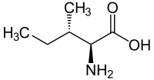
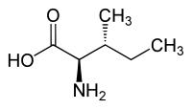
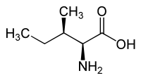
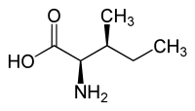
Isoleucine
L-isoleucine (2S,3S) and D-isoleucine (2R,3R)
L-allo-isoleucine (2S,3R) and D-allo-isoleucine (2R,3S)
With a hydrocarbon side chain, isoleucine is classified as a hydrophobic
amino acid. Together with threonine, isoleucine is one of two common
amino acids that have a chiral side chain. Four stereoisomers of isoleucine
are possible, including two possible diastereomers of L-isoleucine. However,
isoleucine present in nature exists in one enantiomeric form,
(2S,3S)-2-amino-3- methylpentanoic acid

